Slide 1
Presenting by THOTAKURA PAVAN
AIRFLY
AIRFLY INSIGHTS
Visualizing Airline Operations for Actionable Intelligence
60M+ Flight Records
Delay Analytics
Route Intelligence
DATA ANALYSIS | VISUAL INSIGHTS | ACTIONABLE INTELLIGENCE

Slide 2
PROJECT OVERVIEW & OBJECTIVES
📊
📈
🎯
DATA ANALYSIS
VISUAL INSIGHTS
ACTIONABLE INTELLIGENCE
Analyze 60M+ airline flight records to uncover operational trends and patterns across routes and carriers.
Focus on delays, cancellations, and route performance through compelling, interactive data visualizations.
Deliver insights for airlines and airports to improve efficiency and enhance the passenger experience.
AIRFLY INSIGHTS

Slide 3
PROJECT MILESTONES
01
Data Collection & Preparation
02
Exploratory Data Analysis (EDA)
03
Delay & Cancellation Analysis
Gathering, cleaning, and structuring raw flight data from various sources to build a robust foundation.
Initial deep dive into datasets to uncover key patterns, relationships, and potential data quality issues.
Detailed examination of root causes and impacts of flight disruptions, identifying critical factors.
04
Route & Airport Analysis
05
Dashboard Development
06
Final Insights & Recommendations
Performance evaluation of specific routes and major airport hubs to pinpoint bottlenecks and efficiencies.
Creation of interactive and intuitive dashboards for real-time monitoring and stakeholder access.
Synthesizing all findings into actionable strategies to improve operational efficiency and passenger experience.

Slide 4
MILESTONE 1: DATA FOUNDATION & CLEANING
01
Data Acquisition
Source large Kaggle Airlines Flights Dataset (60M+ records) efficiently using pandas.
02
Schema Exploration
Understand data types, identify nulls, and optimize memory usage for large-scale datasets.
03
Feature Engineering
Extract Month, Day of Week, Hour, and Route identifiers for granular, meaningful analysis.
04
Data Cleaning
Handle missing delay and cancellation data to ensure robust and reliable analytical insights.
AIRFLY INSIGHTS | DATA FOUNDATION

Slide 5
MILESTONE 2: VISUAL EXPLORATION & DELAY TRENDS
Our analysis identifies the busiest airports and top flight routes, providing a clear operational context.
✈️
Identification of top airlines by flight volume and most active routes.
📅
Visualization of seasonal and daily flight distribution patterns through bar charts and histograms.
⏰
Pinpointing peak travel months and times helps optimize resource allocation and improve efficiency.
🔍
Univariate and bivariate analysis reveals correlations between delay types and operational factors.

Slide 6
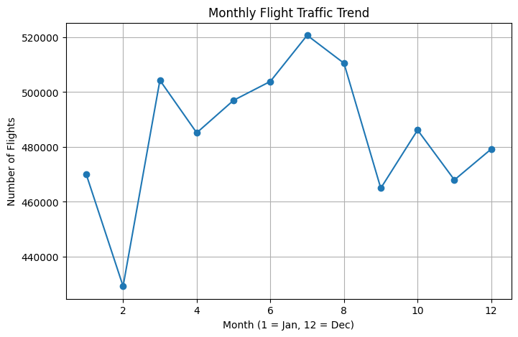
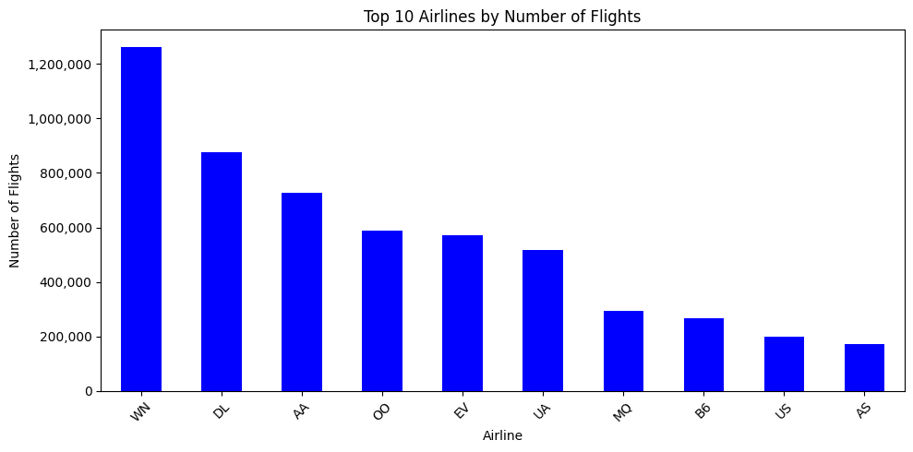
CHART: TOP AIRLINES & MONTHLY FLIGHT TRAFFIC
Top 10 Airlines by Number of Flights
Monthly Flight Traffic Trend
WN leads with 1.2M+ flights, followed by DL and AA — highlighting the dominance of major US carriers.
Peak traffic in summer (Jul–Aug) with dips in Feb. Seasonal patterns drive operational planning.
AIRFLY INSIGHTS | VISUAL EXPLORATION

Slide 7
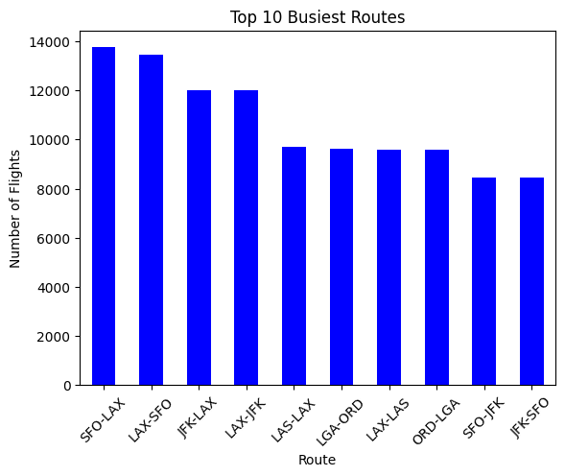
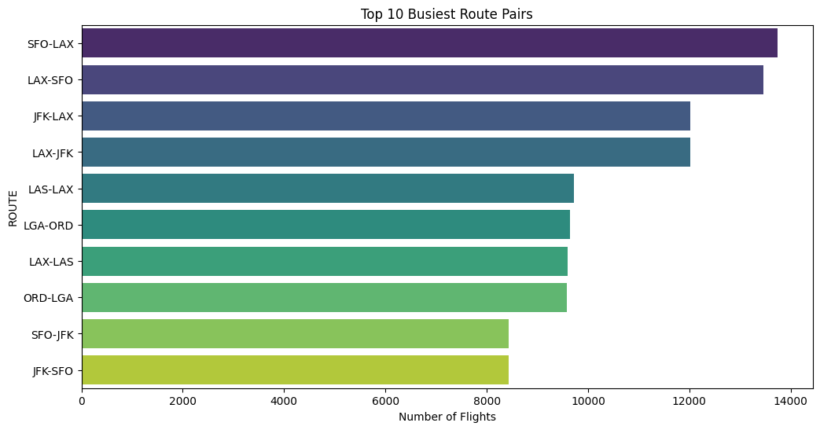
CHART: BUSIEST ROUTES & TOP AIRPORTS
Top 10 Busiest Routes
Top 10 Busiest Airports
SFO↔LAX is the busiest corridor with 14,000+ flights — a high-congestion route prone to delays.
ATL dominates with 350,000+ flights. ORD and DFW follow — all major hubs with high delay exposure.
AIRFLY INSIGHTS | VISUAL EXPLORATION

Slide 8
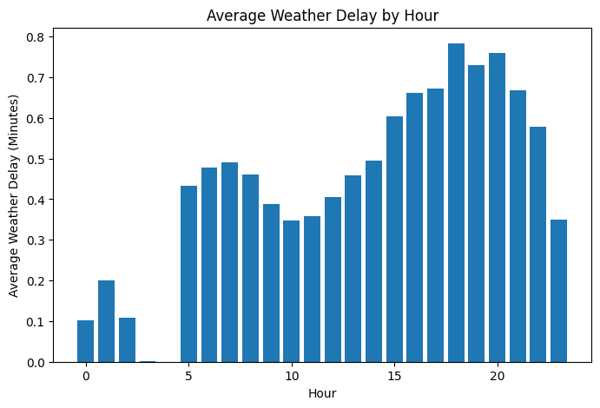
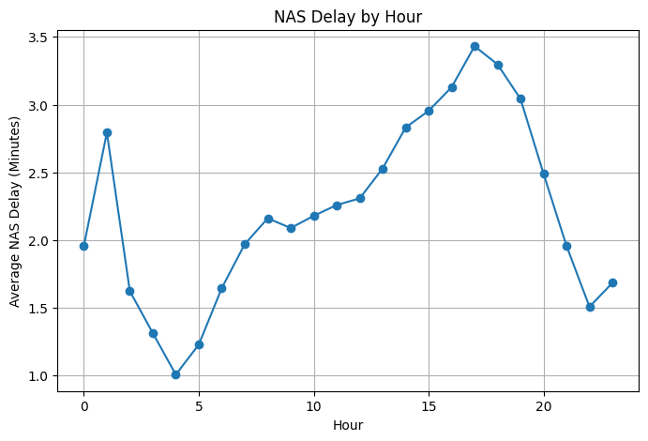
CHART: FLIGHT DISTRIBUTION BY DAY & HOUR
Flights by Day of Week
Flights by Hour of Day
Thursday peaks at 875,000 flights while Sunday drops sharply — revealing weekend travel patterns.
Peak departures from 6–8am with a secondary surge at 3pm. Near-zero activity between midnight–4am.

Slide 9
DELAY ANALYSIS: CAUSES AND PATTERNS
🔎
📊
⚠️
Understanding Delay Causes
Airline Performance Comparison
Identifying Bottlenecks
We break down delays into key categories: carrier issues, weather disruptions, and National Airspace System (NAS) inefficiencies. Each cause requires a distinct mitigation strategy.
Comparative analysis across major airlines highlights carriers with the highest propensity for delays, enabling targeted improvement initiatives.
Time-of-day and airport-level delay heatmaps expose critical operational bottlenecks and stress points in the National Airspace System.
AIRFLY INSIGHTS | DELAY ANALYSIS

Slide 10
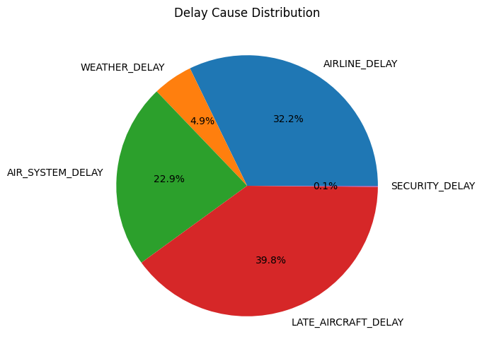
CHART: DELAY CAUSE DISTRIBUTION
BREAKDOWN
Late Aircraft
39.8%
Airline / Carrier
32.2%
Air System (NAS)
22.9%
Weather
4.9%
Security
0.1%
Delay Cause Distribution
Late aircraft cascades are the #1 cause — a systemic issue that compounds throughout the day.
AIRFLY INSIGHTS | DELAY ANALYSIS

Slide 11
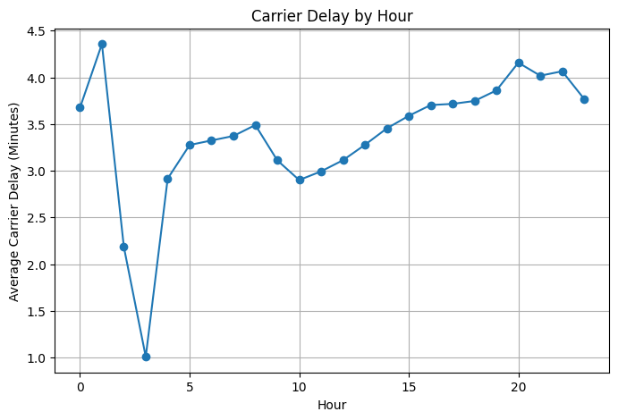
CHART: DELAY PATTERNS BY HOUR OF DAY
Carrier Delay by Hour
NAS Delay by Hour
Carrier delays spike in early morning (1–2am) and again from 8–10pm — peak shift transition periods.
NAS delays build steadily through the afternoon, peaking at 5–6pm — congestion-driven bottleneck.
AIRFLY INSIGHTS | DELAY ANALYSIS

Slide 12
CHART: AVERAGE WEATHER DELAY BY HOUR
Weather delays escalate significantly from noon and peak at 7–8pm. Early morning flights benefit from the lowest weather-related delays.
Average Weather Delay by Hour (Minutes)

Slide 13
MILESTONE 3: ROUTE, CANCELLATION & SEASONAL INSIGHTS
KEY ANALYSIS PERFORMED
KEY INSIGHTS
Identified Top 10 origin–destination flight routes
Created delay heatmaps by airport and route
Visualized busiest airports using geographic maps
Analyzed monthly cancellation trends
Compared cancellation reasons (carrier, weather, security, NAS)
Studied seasonal patterns in flight delays and traffic
Some airport routes show higher delay patterns due to congestion
Peak travel seasons have significantly higher flight activity
Weather and carrier issues contribute most to cancellations
Certain airports experience disproportionately higher operational delays

Slide 14
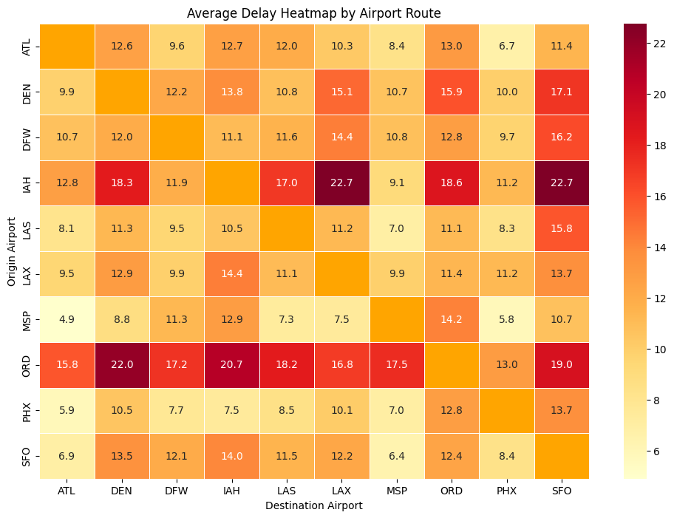
CHART: AVERAGE DELAY HEATMAP BY AIRPORT ROUTE
Average Arrival Delay Heatmap by Airport Route
Darker cells signal higher average delays. SFO, ORD, and JFK routes show the most congestion-driven arrival delays.
AIRFLY INSIGHTS | ROUTE & CANCELLATION ANALYSIS

Slide 15
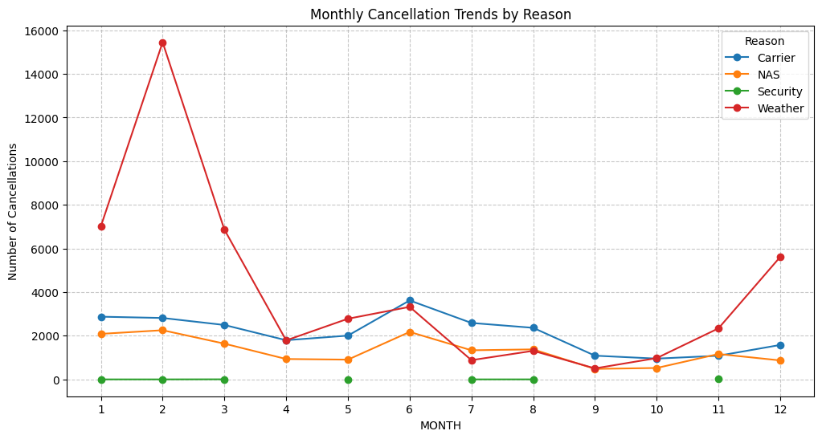
CHART: MONTHLY CANCELLATION TRENDS BY REASON
Monthly Cancellations by Reason (Carrier / Weather / Security / NAS)
Weather spikes in winter months; carrier-related cancellations remain consistent year-round — both require targeted strategies.
AIRFLY INSIGHTS | ROUTE & CANCELLATION ANALYSIS

Slide 16
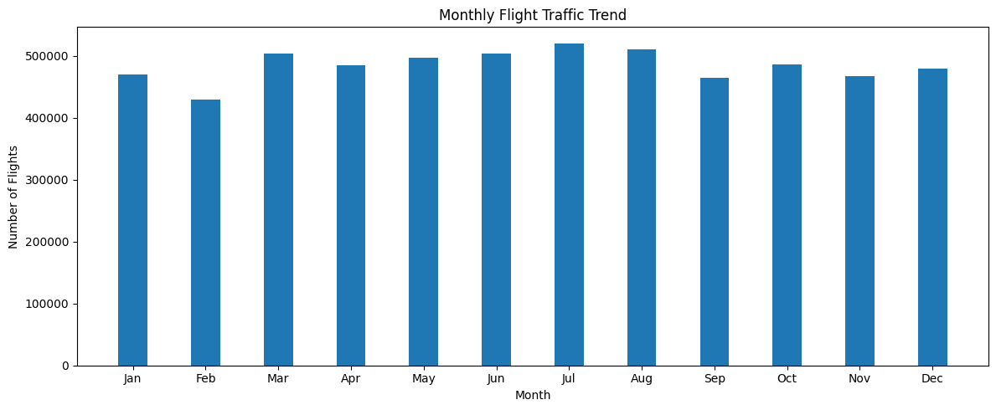
CHART: MONTHLY FLIGHT TRAFFIC
Monthly Flight Traffic — Total Number of Flights Per Month
Summer months (Jun–Aug) and holiday periods see significant traffic surges, contributing to airport congestion and cascading delays.

Slide 17
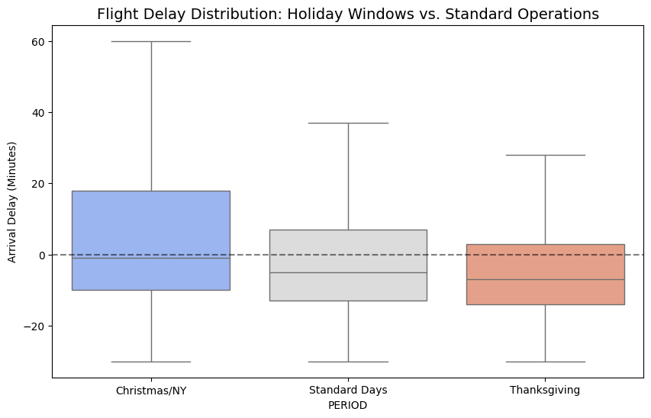
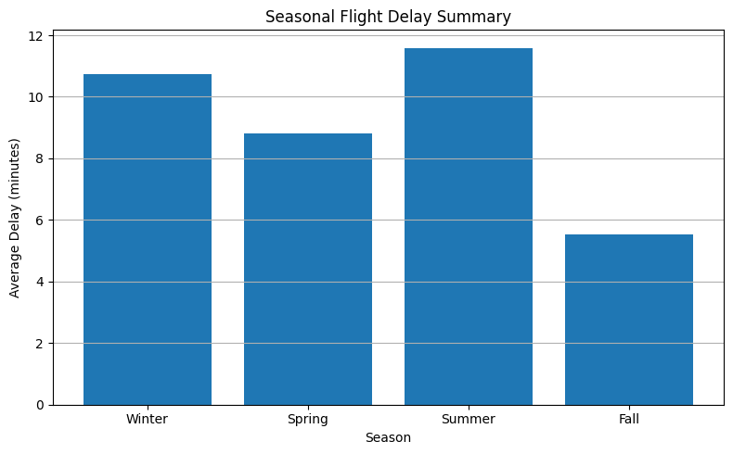
CHART: IMPACT OF HOLIDAYS ON FLIGHT DELAYS
Holiday Delay Distribution
Winter Month Delay Comparison
Thanksgiving and Christmas/New Year show significantly wider delay distributions — higher traffic volumes create compounding operational congestion.
AIRFLY INSIGHTS | SEASONAL INSIGHTS

Slide 18
CANCELLATION & SEASONAL INSIGHTS
Understanding when and why flights are cancelled is crucial for operational planning.
📅
Monthly Trends
🚫
Cancellation Reasons
Monthly cancellation trends highlight peak disruption periods, such as holidays and winter months, revealing seasonal vulnerability windows.
Categorization includes carrier issues, adverse weather, security concerns, and NAS (National Airspace System) failures.
🌦️
Seasonal Factors
🎄
Holiday Impact
Visualizations show the impact of seasonal factors on route congestion and spikes in cancellations during peak travel periods.
Holiday windows such as Thanksgiving and Christmas/New Year show wider delay distributions due to increased air traffic and congestion.
AIRFLY INSIGHTS | CANCELLATION ANALYSIS

Slide 19
MILESTONE 4: REPORT & PRESENTATION
📑 VISUAL REPORT / DASHBOARD
📋 DOCUMENTATION & FINAL DELIVERY
Combine plots into a coherent storyline
Use markdown and presentation slides for clarity
Ensure all plots include labels, titles, legends, and axis clarity
Interactive dashboard built with Streamlit or PowerBI
Real-time monitoring capabilities for stakeholders
Create final report (PDF or comprehensive README)
Build and refine slide deck for live presentation
Record detailed insights and visual walkthrough
Deliver actionable strategies to stakeholders
Document all methodologies and data sources

Slide 20
VISUAL REPORT & DASHBOARD HIGHLIGHTS
🖥️
🔬
🎯
COHESIVE DASHBOARD
CLARITY & INTERPRETABILITY
ACTIONABLE STORYLINE
Integration of diverse plots into a compelling and interactive dashboard using Streamlit or PowerBI, enabling real-time access to all operational insights.
Ensure clear labeling, legends, and annotations for easy understanding by all stakeholders — from data engineers to airline executives.
Craft a narrative built around actionable insights for airline operators and analysts, translating complex data into strategic advantages.
AIRFLY INSIGHTS | DASHBOARD HIGHLIGHTS

Slide 21
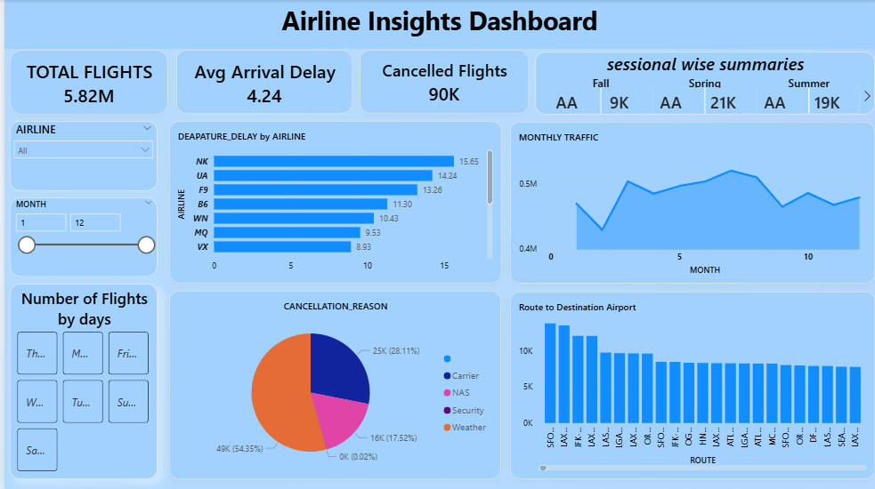
DASHBOARD PRESENTATION
📋 DOCUMENTATION & FINAL DELIVERY

Slide 22
CONCLUSION
AirFly Insights empowers data-driven decision-making, transforming complex aviation data into strategic advantages.
⚡
Future work includes real-time data integration for immediate, actionable insights.
🤖
Development of AI-driven predictive analytics to anticipate and prevent disruptions.
📱
Expansion of dashboard features for more comprehensive operational control.
🤝
We invite stakeholder collaboration to implement findings and enhance air travel experience.
AIRFLY INSIGHTS
Data-Driven Aviation Intelligence

